Slide 1
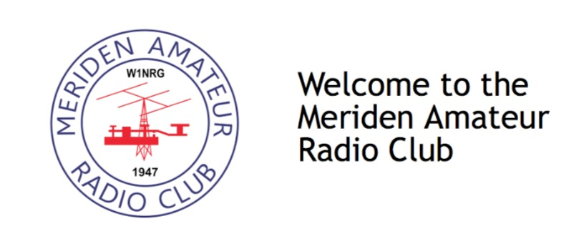
ACTIVITY NIGHT
August 24, 2017

Slide 2
A FOX HUNTING PRIMER
By N1ZN
Disclaimer
Will not teach you everything you hoped to learn.

Slide 3
ARDF
Amateur Radio Direction Finding
aka Fox Hunting
aka T-Hunting

Slide 4
What is Fox Hunting or T-Hunting?
Searching for a hidden transmitter
that is transmitting a signal.
It may be continuous transmissions
or intermittent.
The most common band is 2 meter FM.
A common Fox Hunt frequency is 146.565.

Slide 5
Participants
The Hunters can be individuals or teams.
Locations
Range can be up to hundreds of miles.
Winning
Typically the first to locate the fox.
Variation: the lowest mileage in locating the fox.

Slide 6
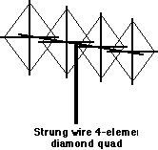
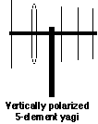
Equipment
Antenna is the key!
Beams - Directivity provides an advantage.
Cubical Quads
Yagis
Polarization is important!

Slide 7
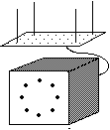
Dual Antennas
a pair of verticals with a switching device.
Dopplers
typically 4 whip antennas with a ring of leds

Slide 8
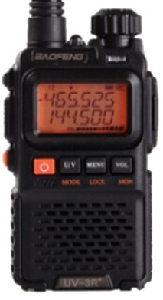
using Handi-Talkies or Scanners
Body Fade or Body Shielding
Move off frequency 5 – 10 KHz
Remove the rubber ducky antenna

Slide 9
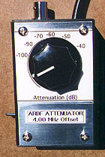
Attenuation
A necessity when very close to the transmitted signal.
Offset attenuator
Third Harmonic
146.565 KHz
X 3 =
439.695 KHz

Slide 10
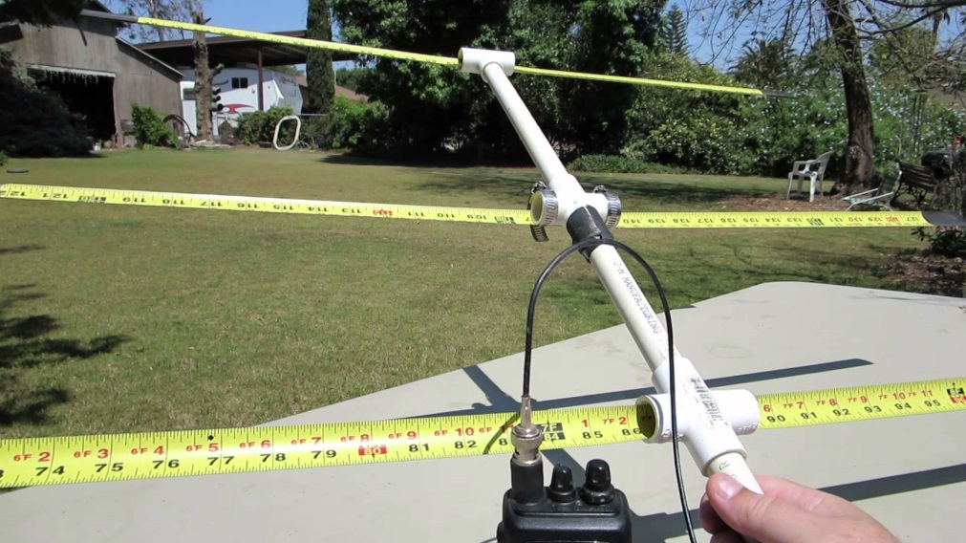
Directional Antennas
Popular is the “Tape Measure Antenna”
Yagi made from ½” pvc pipe
Elements made from a 1” tape measure
Simple hair pin match

Slide 11
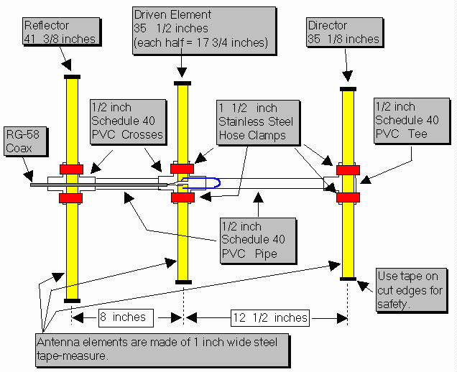
WB2HOL Design

